Slide 1


e-commerce
Capstone Project
Mentor and Advisor:
Karthikeyan Sankaran

Slide 2




Group Members:
Abhijeet Karki
Bishnu Sethy
Chandrakanth Nagaraj
Nitin Srivastava

Slide 3
Content:
Background - Ecommerce Case Study
Data Understanding, Preparation and EDA
List of engineering KPI
Iteration of basic linear model
Notes for continuation of this project to submit in Final submission
Price Elasticity
Return on Investment

Slide 4
Background - Ecommerce Case Study:
ElecKart is an e-commerce firm specializing in electronic products. Over the last one year, they had spent a significant amount of money in marketing.
Occasionally, they had also offered big-ticket promotions (similar to the Big Billion Day). They are about to create a marketing budget for the next year which includes spending on commercials, online campaigns, and pricing & promotion strategies.
The CFO feels that the money spent over last 12 months on marketing was not sufficiently impactful, and, that they can either cut on the budget or reallocate it optimally across marketing levers to improve the revenue response.
The analysis has been divided into four parts for this submission:
Data Understanding, Preparation and EDA
List of engineering KPI
Model Generation & Evaluation
Notes for continuation of this project

Slide 5
Data Understanding, Preparation and EDA: Major Attributes
Attribute | Description
FSN ID | The unique identification of each SKU
Order Date | Date on which the order was placed
Order item ID | Suppose you order 2 different products under the same order, it generates 2 different order Item IDs under the same order ID; orders are tracked by the Order Item ID.
GMV | Gross Merchandise Value or Revenue
Units | Number of units of the specific product sold
Order payment type | How the order was paid – prepaid or cash on delivery
SLA | Number of days it typically takes to deliver the product
Cust id | Unique identification of a customer
Product MRP | Maximum retail price of the product
Total Investment | Monthly spends on various advertising channels
The data received for the analysis has 20 attributes in Consumer Data 12 attributes in Media Data.
The important ones are –

Slide 6
Data Understanding, Preparation and EDA: Major Attributes
Following are Marketing spends in cr listed by Media team , they are listed for certain months only
important ones based on sanity check and domain understanding are highlighted in bold
TV
Digital
Sponsorship
Content Marketing
Online marketing
Affiliates
SEM
Radio
Other
NPS score is provided which is can be considered as customer satisfaction of the company ElecKart
Special Sales calendar is provided along with data range which can impact sales
Lastly product list

Slide 7
Data Understanding, Preparation and EDA: segmentation of data
Sector
Camera Accessories (~ 250000 orders)
Gaming Accessories (~ 190000 orders)
Home Audio (~ 120000 orders)
The “Sub Category” to be analyzed are listed below:

Slide 8
Data Understanding, Preparation and EDA: Derived Attributes
Attribute | Description
Discount | Discount given during Sales
Weekly Sales | Volume sales on weekly basis
Monthly Sales | Volume sales on monthly basis
Few of derived Attributes are below.
There might be few more as we continue with our analysis and modelling.
adStockAdvt | Impact of Investment on next 4 weeks*
PromotionWeek | Identifies if there was any Promotion (Sales campaign) during the week
* EDA shows a lag of 4 weeks as a Carry over effect of media. Adstock rate of 0.2 assumed for preliminary analysis.

Slide 9
Data Understanding, Preparation and EDA: Data Preparation
Weekly Aggregation and ordering of Orders
NA check
Orders with NA value of GMV are also missing values for cust_id and pincode. Orders removed.
Invalid Values
Orders with zero value of MRP removed.
Orders with negative values of sla attribute removed.
Sales Week Tagging
Categorical variable ‘Payment Type’ converted into numeric values (COD = 1, Prepaid = 0)

Slide 10
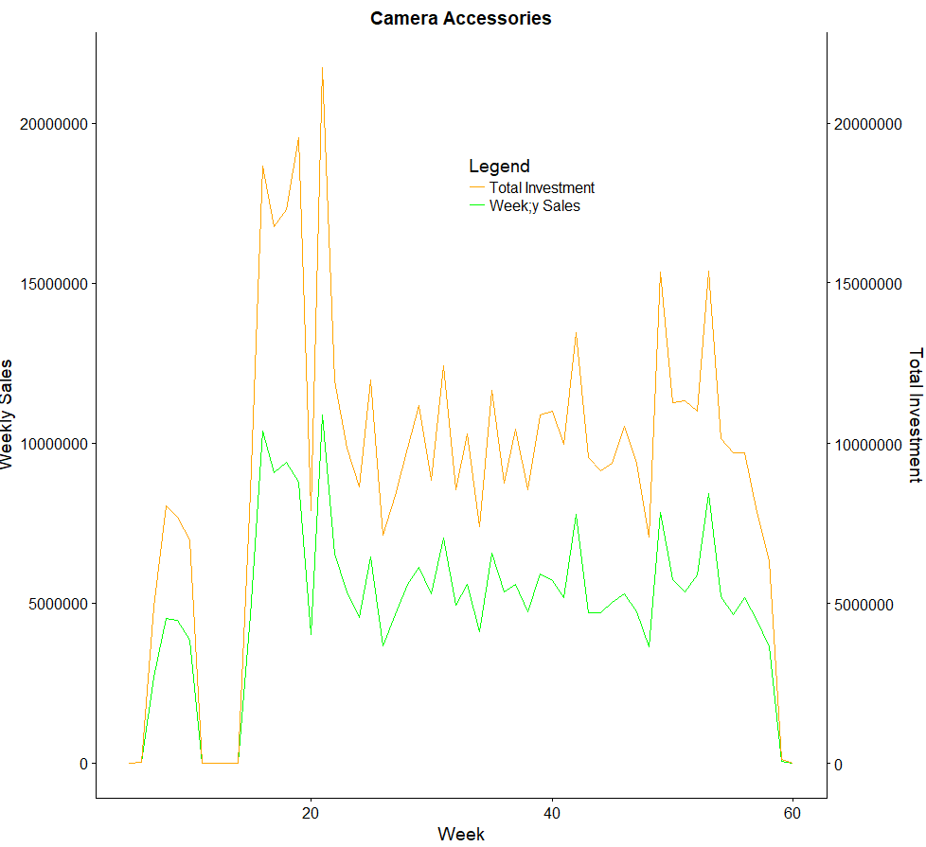
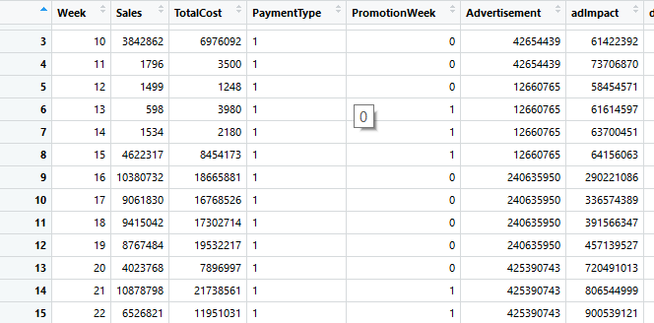
Data Understanding, Preparation and EDA: Data Visualization
Weekly Sales – Camera Accessories
Graph shows Weekly Sales and Media Investment of Camera Accessories.
Between week 15 – 21, sales is peak, Week 21 recording highest

Slide 11
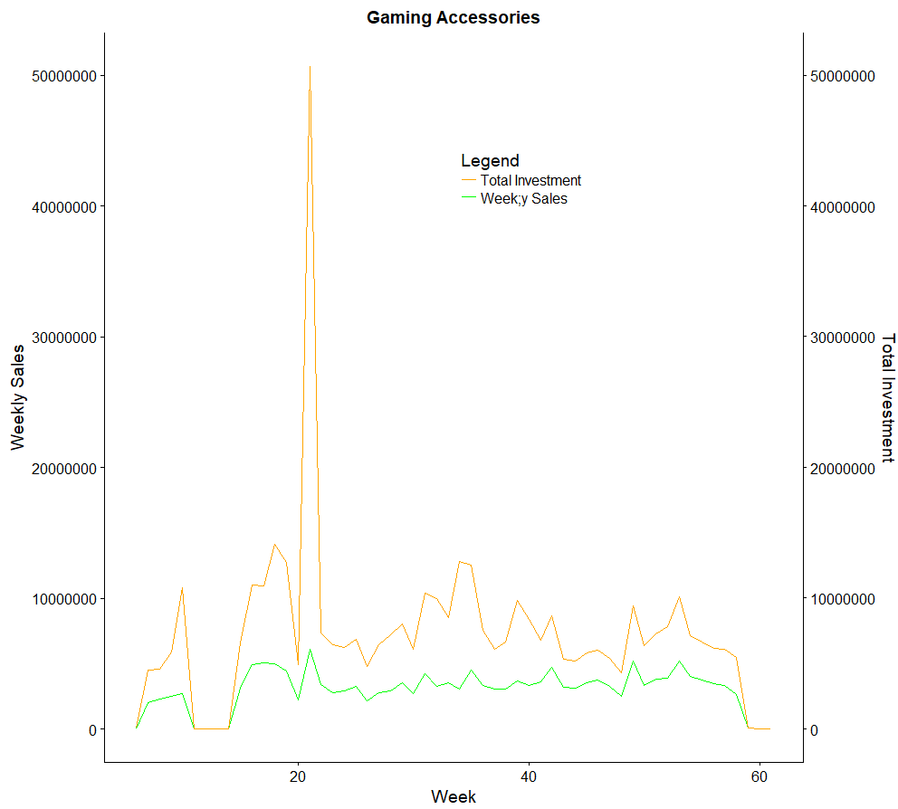
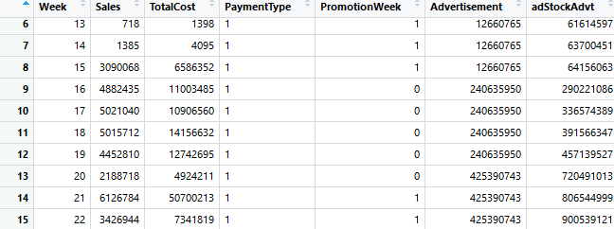
Data Understanding, Preparation and EDA: DATA VISUALIZATION
Weekly Sales – Gaming Accessories
Graph shows Weekly Sales and Media Investment of Gaming Accessories.
Week 21, sales has highest peak.

Slide 12
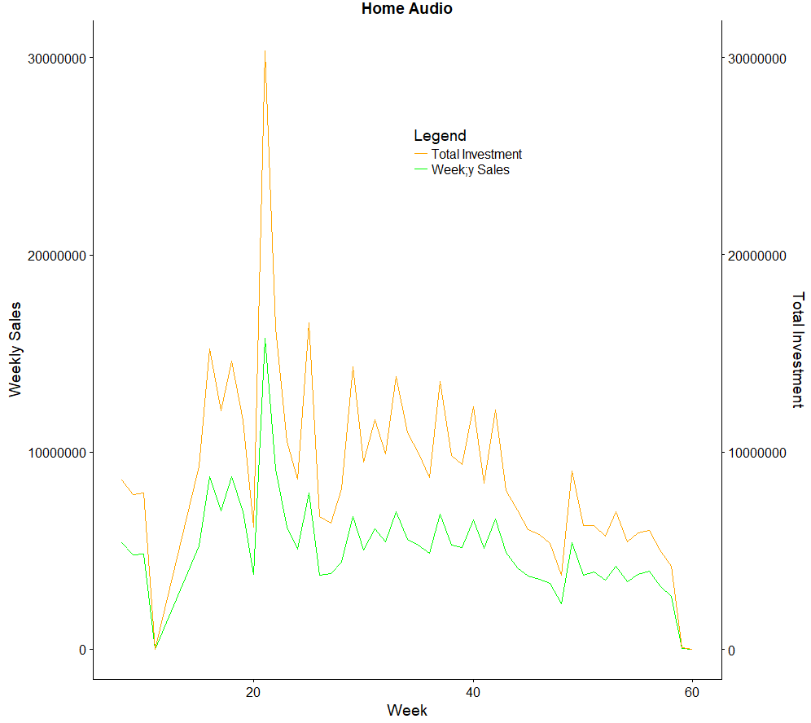
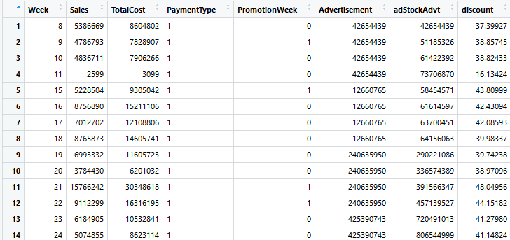
Data Understanding, Preparation and EDA: DATA VISUALIZATION
Weekly Sales – Home AUDIO
Graph shows Weekly Sales and Media Investment of Home Audio.
Week 21, sales has highest peak

Slide 13
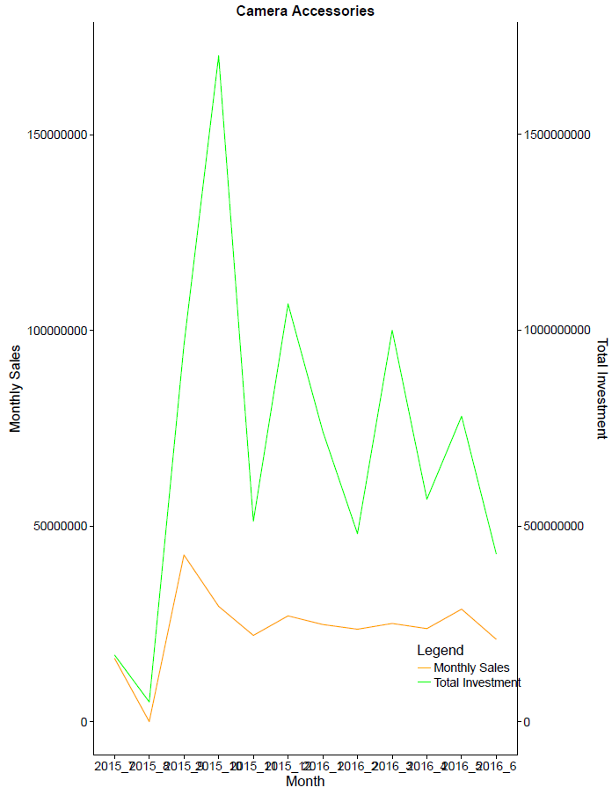
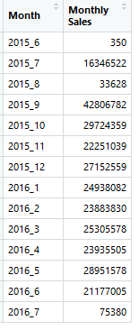
Data Understanding, Preparation and EDA: DATA VISUALIZATION
MONTHLY Sales (camera accessories) v/s media investment
Graph shows monthly Camera Accessories sales v/s Media investment.
Graphs show a Carry Over Effect of media investment impact on Sales for 1 month

Slide 14
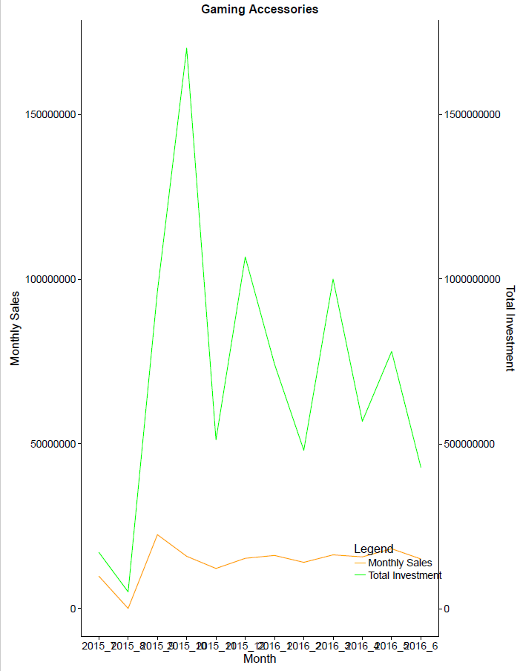
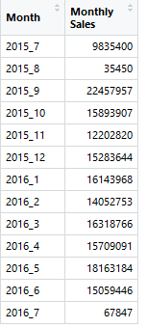
Data Understanding, Preparation and EDA: DATA VISUALIZATION
MONTHLY Sales (GAMING accessories) v/s media investment
Graph shows monthly Gaming Accessories sales v/s Media investment.
Graphs show a Carry Over Effect of media investment impact on Sales for 1 month

Slide 15
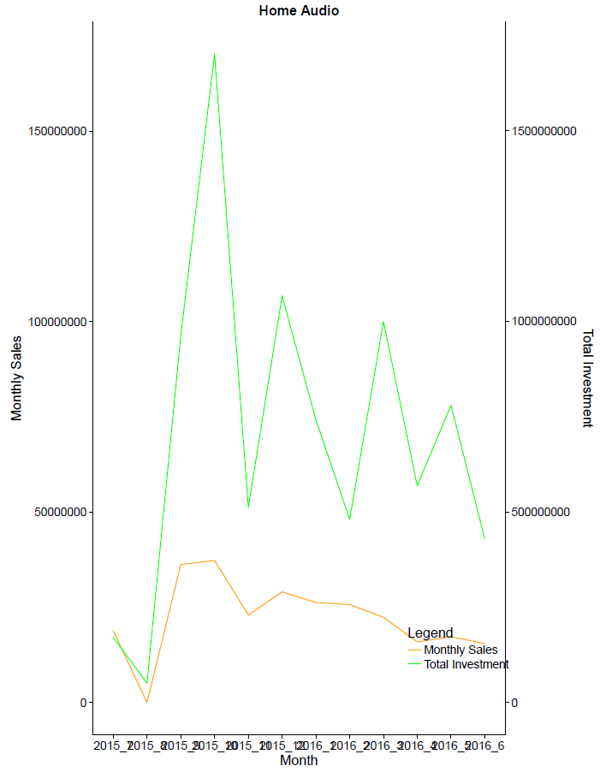
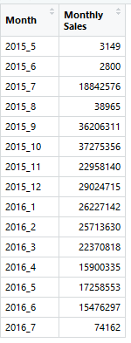
Data Understanding, Preparation and EDA: DATA VISUALIZATION
MONTHLY Sales (HOME AUDIO) v/s media investment
Graph shows monthly Home Audio v/s Media investment.
Graphs show a Carry Over Effect of media investment impact on Sales for 1 month

Slide 16
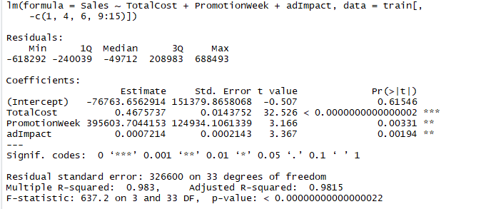
Model GENERATION/ Evaluation:
LINEAR REGRESSION – Camera accessories
Split Ration of 70:30 in training and testing data
Product MRP and PromotionWeek and Adstock identified as relevant attributes.
No multicollinearity in the model.
Additional Improvement to be done as mentioned under ‘Notes for continuation of this project’.

Slide 17
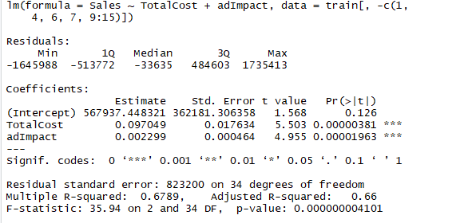
Model GENERATION/ Evaluation:
LINEAR REGRESSION – GAMING accessories
Split Ration of 70:30 in training and testing data
Product MRP and AdImpact identified as relevant attributes.
No multicollinearity in the model.
Additional Improvement to be done as mentioned under ‘Notes for continuation of this project’.

Slide 18
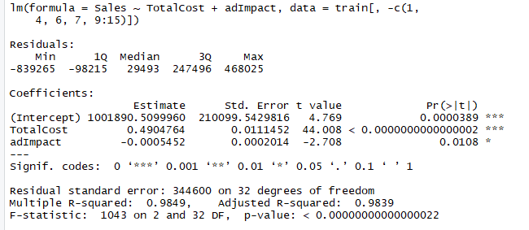
Model GENERATION/ Evaluation:
LINEAR REGRESSION – HOME AUDIO
Split Ration of 70:30 in training and testing data
Product MRP and AdImpact identified as relevant attributes.
No multicollinearity in the model.
Additional Improvement to be done as mentioned under ‘Notes for continuation of this project’.

Slide 19
Notes on Continuity:
MRP ,GMV vs Media spend (cr) and some other attributes are not in same scale. To explore impact of scaling.
Incorporate effect of NPS score.
Investigate and possible implement a way to compute AdStock rate ( current approach has hardcoded value 0.2).
We aim to derive Adstock rate
- Based on manual check of chart from carry over effect
- Using nlsLM function from R package minpack.lm
Explain ROI in Sales against media investment
- For every change in investment what is effect on Sales
Explain effect of variables from transactional data-set on the sale
Model and Identify impact of investment in diverse channels of media for optimizing Marketing spend.
Time series decomposition of Weekly Sales data to understand Seasonality and Trend.
Other Linear Regression Model Comparison/ Evaluation – Basic Model, Multiplicative Model , Exponential Attraction
Examine Other ML algorithm for better results.

Slide 20
THANK YOU

